Slide 1
Snake game
By Anjali Desai and Rumana Yeasmin

Slide 2
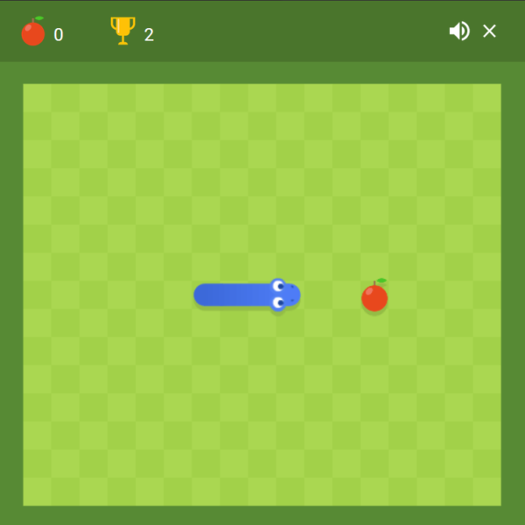
Snake Game
We made this Snake game as a way to pass time when one is bored and they just want to play an easy computer game that has a simple objective and can be played over and over again.

Slide 3
What does the snake game do?
In the game, we are set up with a snake and the snake must eat the food which is the red food block and if succeeded the snake has fulfilled their purpose. The game is supposed to be continuous and you can get as many food as you can but if you exit the paramereters then it will be a game over for the player.

Slide 4
What did you do to make this?
-I had made the source code and we had used resources like udemy to make our game and make the source code.
-We have three source code files that contain pivotal parts of the code.
-Rumana made the Direction folder.
-I focused on trying to make the snakegame source code. This source code file is to set the background and the visual of the game.
-The file Snake is to construct the snake part of the game in which how the snake moves and hwo they look. We can modify the shape of the snake and it can look like any shape or size chosen.

Slide 5
Learning objectives
We learnt many things while working on this project. We were able to utilize many materials that we had learned during the course and applying these towards our project. Understanding what each part of the code should be doing and navigating how to trouble shoot these parts. We learned how to incorporate for loops to make our game become more recursive. We implemented the concept of polymorphism and demonstrating the relationship the superclass and subclasses and the objects and methods related to each. We also learnt how to construct UML diagram that was imperative to plan out how this code should be made. We also learnt how to use JavaFX in order to create a GUI based program which for us was a game app. We also implemented some new features in order to make sure that our snake game was easy to view and play. We hope to improve our snake game by adding some more user friendly features like a score board. At the end, we did not have enough time to troubleshoot our problem which was to get the snake to grow after eating the food so that way the player could keep going. But we hope to fix these features soon. This process was a trial and error but at the end it was cool to see how JavaFX and GUI helps create apps that we use in our everyday lives!

